Slide 1


Visual and Statistical Analysis of Olympic Legacy
By- Pola Lokesh
Kakatiya Institute of Technology & Science

Slide 2

PROBLEM STATEMENT
Despite over a century of documented Olympic history spanning from 1896 to 2016, there remains a need to comprehensively analyze and Visual Insights on the evolution and trends of Olympic participation, achievements, and demographic shifts. This project aims to explore and present insights through visual and statistical analysis, uncovering patterns in athlete demographics, national performance trends, and the impact of gender dynamics on Olympic outcomes. By leveraging Power BI, this study seeks to provide a nuanced understanding of the Olympic legacy across summer and winter games, shedding light on key factors influencing athletic success and global sporting prominence.

Slide 3
Project Description
This project aims to explore 120 years of Olympic history from 1896 to 2016 through comprehensive data visualization and statistical analysis using Power BI. It seeks to uncover insights into athlete demographics, including the youngest and oldest Olympians, and examine gender dynamics in participation.
By comparing Summer and Winter Games, the project will elucidate variations in sports participation and medal distributions over time. Ultimately, this study aims to provide a nuanced understanding of the evolving global sporting landscape and the historical influences shaping Olympic achievements.

Slide 4

WHO ARE THE END USERS?
Sports Researchers and Historians: Individuals interested in studying the evolution of sports, Olympic achievements, historical trends over past 120 years.
Media and Journalists: Professionals seeking data-driven insights and visualizations to enhance reporting on Olympic history, trends, and current events.
Educators and Students: Teachers and students looking to understand global sports history, demographic shifts in athletes, and the impact of gender dynamics on sports participation.
General Public and Sports Enthusiasts: Individuals curious about the Olympics, interested in exploring historical data, and gaining insights into global sports achievements and cultural impacts.

Slide 5
This methodology outlines a structured approach to conducting a Power BI project on the Olympics dataset, emphasizing data integrity, thorough analysis, and actionable insights derived from historical Olympic data spanning 120 years. 1. Data Collection and Preparation: Data Sources: Gather historical data spanning 1896 to 2016 from reliable sources such as official Olympic databases, research publications, and historical records. Data Cleaning: Utilize Microsoft Excel for initial cleaning tasks including removing the duplicates, handling missing values, and standardizing formats. Data Integration: Prepare the dataset for Power BI by integrating cleaned datasets from multiple sources if necessary. Perform additional transformations as needed for analysis.
Methodology

Slide 6
2. Data Analysis and Visualization: Power BI Setup: Import the prepared dataset into Power BI and establish data relationships among tables (e.g., athletes, events, countries). Visualization Creation: Develop interactive dashboards and reports in Power BI to visualize trends in athlete demographics, national performance, medal distributions, and gender dynamics over 120 years. Statistical Analysis: Utilize Power BI’s built-in capabilities or external tools (e.g., Excel for complex statistical functions, R or Python for advanced analysis) to derive insights such as average age of Olympians, gender ratio trends, and correlations between athlete demographics and medal counts. 3. Comparative Analysis: Summer vs. Winter Olympics: Compare and contrast participation rates, sports categories, and medal distributions between Summer and Winter Games. Country Performance: Analyze and rank countries based on total medals won, trends over time, and factors contributing to their success (e.g., population size, investment in sports).

Slide 7
4. Interpretation and Insights: Key Findings: Summarize and interpret key insights from the data analysis, such as demographic shifts among Olympians, historical trends in medal counts, and the impact of geopolitical events on participation. Implications: Discuss implications of findings for sports policy, athlete training, and future Olympic Games planning based on historical data patterns. 5. Documentation and Reporting: Documentation: Document the entire process including data sources, cleaning procedures, transformations applied, and analysis methodologies for transparency and reproducibility. Reporting: Prepare a comprehensive report or presentation highlighting significant findings, visualizations, and recommendations based on the analysis. 6. Validation and Review: Peer Review: Engage stakeholders, domain experts, or peers to validate analysis methods, interpretations, and conclusions. Iterative Improvement: Incorporate feedback to refine visualizations, analyses, and insights to enhance the quality and relevance of the final deliverables.

Slide 8
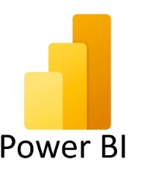



Technology Used
Power BI
Tableau
Power Point
Jira
Asana
Trello

Slide 9
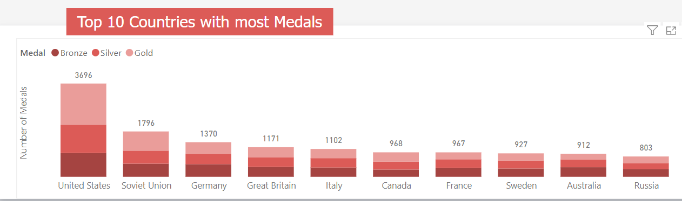
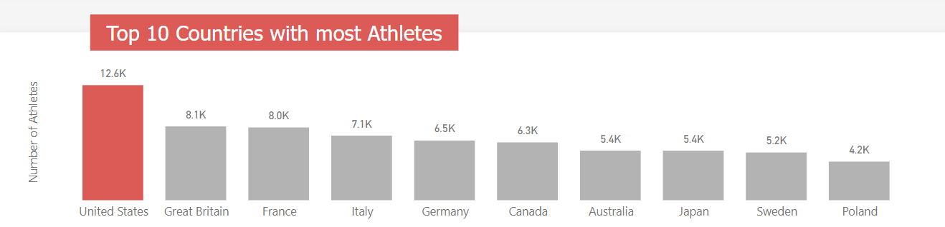
RESULTS

Slide 10
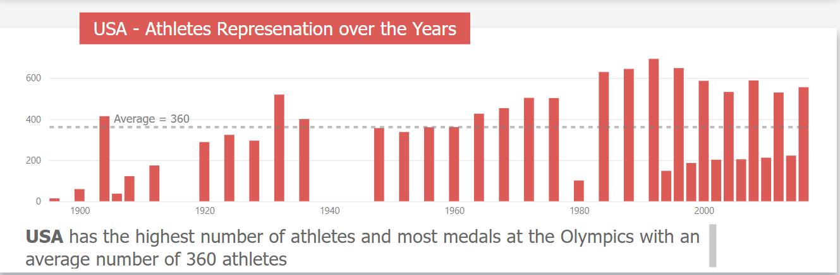

Slide 11
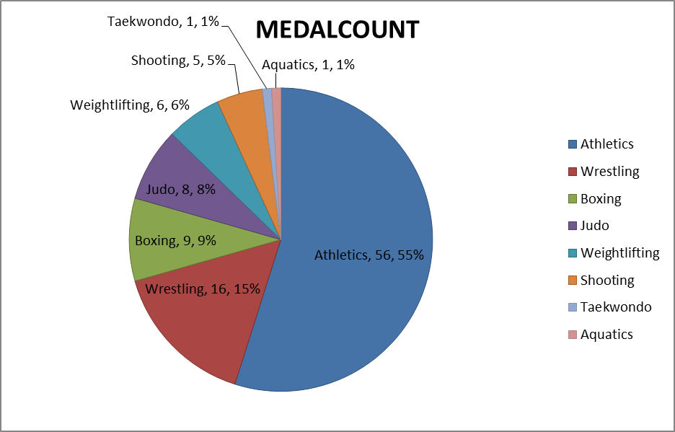

Slide 12
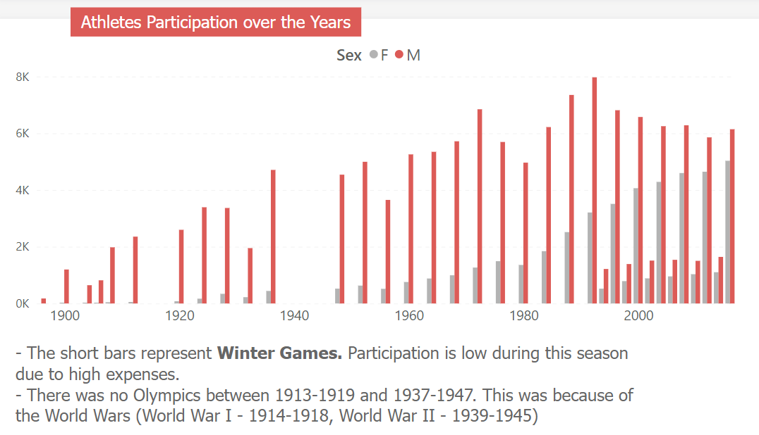

Slide 13
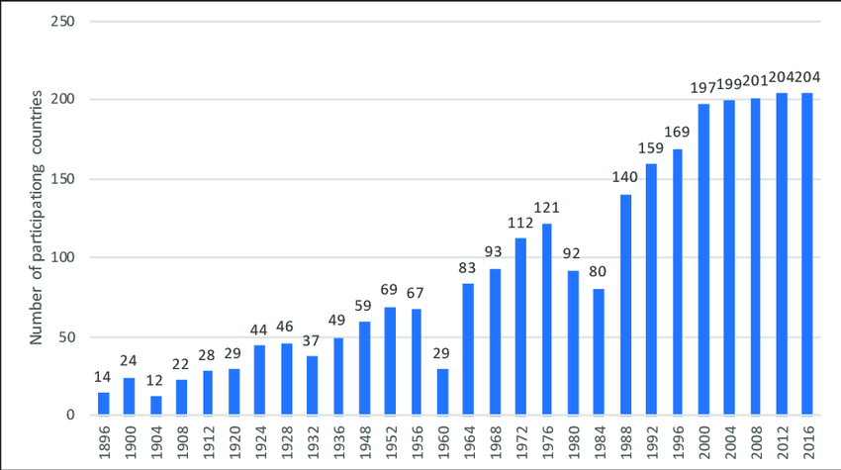

Slide 14
Thank you
.
.

